Slide 1
Loan Delinquency Analysis
Business Analyst Team
Israel Davidson, Fiona Huang, Melanie Jalbert, Ying Lin Zhao

Slide 2
Project Overview
Problem: With rising interest rates, inflation, and post-pandemic economic uncertainty, loan delinquency has become an increasingly urgent issue in the U.S. credit landscape.
Raise concerns about borrower reliability and the potential financial risks for loan providers

Slide 3
Project Overview
Data: Credit Survey from Federal Reserve Bank
Inflation rate, Interest rate, GDP from other source
Goal:
What are some characteristics of consumers that have high delinquency rate?
Given both consumer credit data and macroeconomic data, can we predict the probability of having a 90-day loan delinquency?

Slide 4
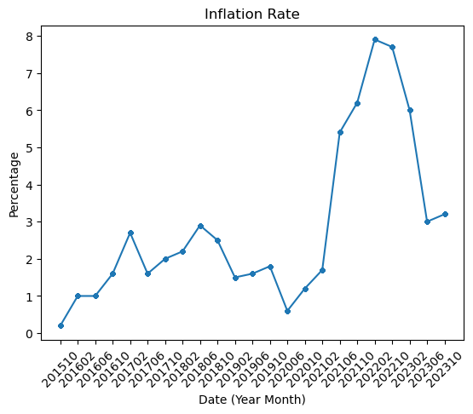
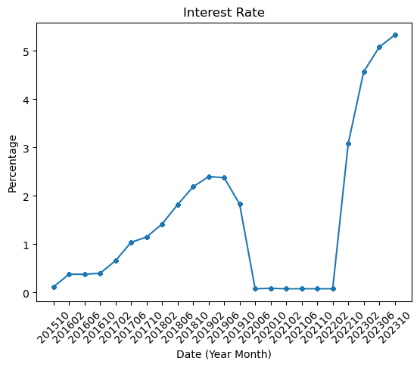
Literature/Background
Loaner vs Borrower
Macroeconomic Factors
Spike in inflation rate during Jun 2021
COVID-19: Jan 2021
Spike in interest rate during Feb 2022
To combat high inflation rate
Concern for loan delinquency rate after the resumption of loan payment collection in 2022
COVID
COVID

Slide 5
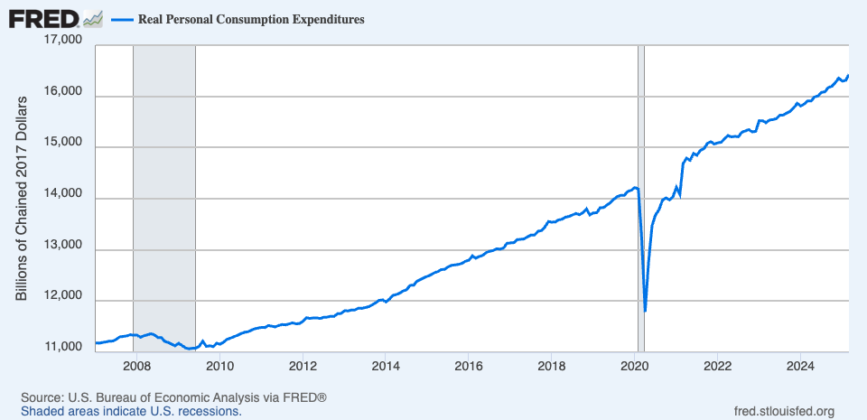
Literature/Background
Microeconomic Factors
Increase in spending
More debt
Age
Marital Status
Credit score
Income
Minimum wage not meeting living wage

Slide 6
Key Findings
Predict if an individual has 90+ days late payment using credit survey answers about personal loan history, inflation rate, interest rate, and gdp
Total Balance, Auto Loan Balance, and Credit Balance found to have an effect on 90+ days delinquency rate
High credit scores are less likely to have 90-day delinquency

Slide 7
Data Exploration

Slide 8
Data Description
Monthly Inflation Rate (1914-2025)
Monthly Interest Rate (1955-2025)
GDP (1960 - 2025)
Date (Year-Month) | Inflation Rate
1914-01 | 2.0
1914-02 | 1.0
1914-03 | 1.0
1914-04 | 0.0
1914-05 | 2.1
Date (Year-Month) | Interest Rate
1955-01 | 1.39
1955-02 | 1.29
1955-03 | 1.35
1955-04 | 1.43
1955-05 | 1.43
Year | GDP (Billion USD) | GDP Per Capita
1960 | 542 | 2999.86
1961 | 562 | 3059.16
1962 | 604 | 3236.36
1963 | 637 | 3366.37
1964 | 684 | 3565.31
Source: US Inflation Calculator
Source: US Bureau of Labor Statistics
Source: World Bank

Slide 9
Data Description
Survey of Consumer Expectation: Credit Survey
Data shape after cleaning: n = 18797, p = 24 predictors
Loan balance
Credit score
Answer to 25 survey questions
Date (2015/10 - 2023/10)
Inflation rate
Interest rate
GDP
UserID | Date | Have Credit Card | Have Mortgage | Have Student Loan | Have HomeBase Loan | HaveAuto | Credit Balance | … | 30Days Late? | 90Days Late? | Credit Score | Last Checked Credit
70000337 | 201510 | 1 | 0 | 0 | 0 | 0 | 0.0 | … | 0 | 0 | 4 | 5
* A sample record from the data
Notes:
Mention how credit score and last checked credit score is categorical

Slide 10
Data Description
Survey of Consumer Expectation: Credit Survey
y = whether an individual has loan payments late by more than 90 days in past 12 months
(0 for not late, 1 for late)
Unbalanced Data:
18301 ontime payments
496 90+ day late payments
UserID | Date | Have Credit Card | Have Mortgage | Have Student Loan | Have HomeBase Loan | HaveAuto | Credit Balance | … | 30Days Late? | 90Days Late? | Credit Score | Last Checked Credit
70000337 | 201510 | 1 | 0 | 0 | 0 | 0 | 0.0 | … | 0 | 0 | 4 | 5
* A sample record from the data

Slide 11
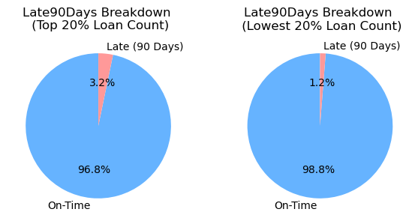
Data Exploration
All have credit card
Highest loan balance types: Mortgage, Student Loan
High Loan Count: 3 different types of loans
Low Loan Count: 1 different type of loan
Notes:
The average credit card balance is 8379.086822360807
The average mortgage balance is 93631.39299525725
The average student loan balance is 11228.581730025902
The average home based loan balance is 3687.5446938008727
The average auto loan balance is 8678.93367926481

Slide 12
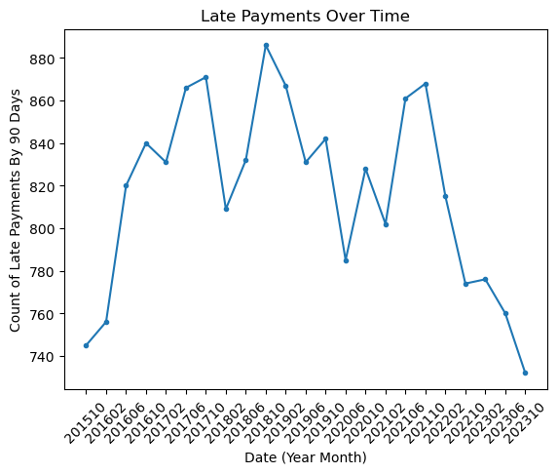
Data Exploration
High inflation rate correlated with high delinquency count
High interest rates correlated with lowering delinquency count

Slide 13
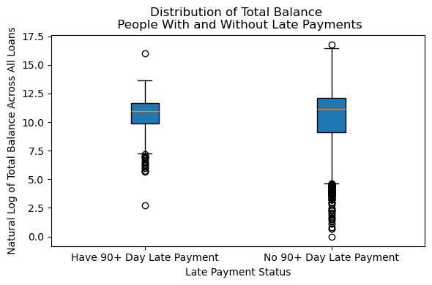
Data Exploration
Those with a 90+ day late payment do not usually have smaller debts
People without late payments have a wider spread of total loan balances

Slide 14
Data Preprocessing
Joined Credit Survey with Inflation rate, Interest rate, and GDP data based on Date (Year-Month)
Removed unnecessary variables
Late30Days, userid, date, year, etc.
Late90Days, was converted to a binary categorical variable with levels ‘late’ and ‘not late’

Slide 15
Data Preprocessing
Applied resampling due to imbalance
Downsampling
Upsampling
Hyperparameter Tuning
70/30 stratified train-test split

Slide 16
Methodology/Models Used

Slide 17
Models Used
Goal: Predict loan delinquency (late payments) based on various features such as credit score, loan types, and financial indicators.
Models Applied:
Logistic Regression
Random Forest
HistGradientBoostingClassifier

Slide 18
Resample Strategies
Resampling Strategies:
Downsampling: Reduce majority class (non-delinquent) to balance data
Upsampling: Increase minority class (delinquent) to balance data
Hyperparameter Tuning: Applied using Grid Search with cross-validation to find the best parameters for each model

Slide 19
Model Metrics
Key Evaluation Metrics:
Accuracy: Model correctness
Recall (Late): How well the model detects delinquencies
F1-Score (Late): Balance of precision and recall for delinquencies
Upsampling vs Downsampling:
Upsampling generally improves recall for the minority class (delinquent)
Downsampling balances performance between both classes

Slide 20
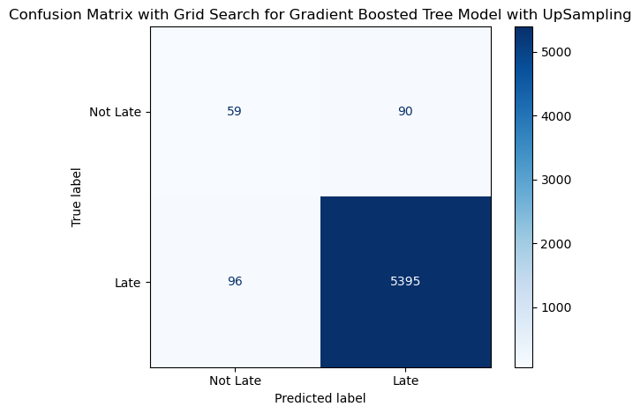
Model Performance Summary
Best Model: Upsampled HistGradientBoostingClassifier
Accuracy: 97%
Recall (Late): 34%
F1-Score (Late): 35%
Precision(Late): 38% (Highest for detecting delinquencies
Best balance between accuracy and model interpretability

Slide 21
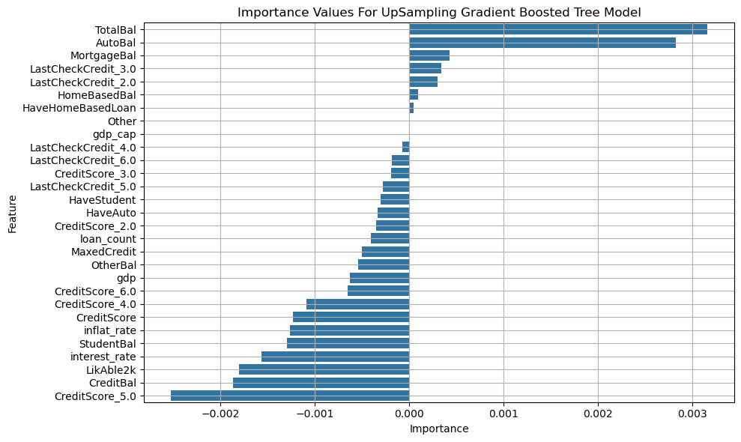

Slide 22
Model Performance Summary
Other Models:
Logistic Regression (Upsampled): Accuracy 88%, F1-Score 28%
Random Forest (Upsampled): Accuracy 96%, F1-Score 26%

Slide 23
Robustness
Evaluated 5-fold stratified cross-validation stability for each of the 3 models
Trained models on both the upsampled and downsampled data to address class imbalance
Tested various hyperparameter combinations to ensure consistent model performance
Upsampled HistGradientBoostingClassifier performed consistently and well across the variations

Slide 24
Conclusions

Slide 25
Significance
Model can help identify borrowers who are likely to become delinquent in their student loans
Not recommended to use model to identify borrowers who will pay on time
Many borrowers are flagged as on-time but are actually delinquent

Slide 26
Next Steps
Consider changing the threshold for flagging someone as likely to have late payments.
Reduce number of borrowers incorrectly tagged as on-time payers
Explore other features that may be more significant for the prediction task
Ratios or combinations of features could be explored
Personal Characteristics: Age, marital status, monthly income, monthly spending

Slide 27
Acknowledgements
Office of Federal Student Aid
Sreyoshi Das and STSCI 4850 TA Team
STSCI 4850 Students

Slide 28
References
https://fred.stlouisfed.org/series/PCEC96#
https://doi.org/10.3390/jrfm14070320
https://ssrn.com/abstract=3836404 https://www.newyorkfed.org/microeconomics/databank.html
https://www.usinflahttps://data.bls.gov/pdq/SurveyOutputServlettioncalculator.com/inflation/historical-inflation-rates/
https://data.bls.gov/pdq/SurveyOutputServlet

Slide 29
Appendix
Logistic Regression Confusion Matrices
Random Forest Classifier Confusion Matrices
Gradient Boosted Tree Model Matrix

Slide 30
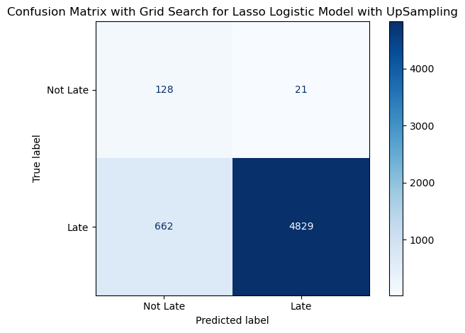
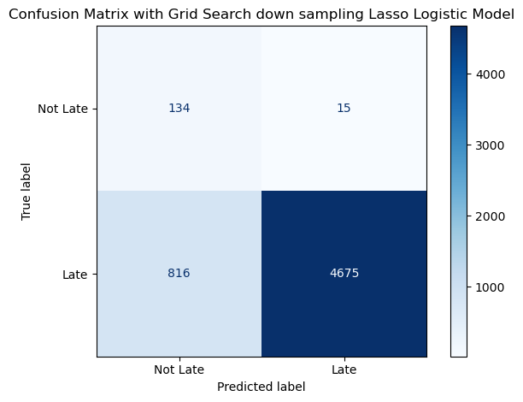
Appendix [1]
Confusion Matrix with Grid Search for Logistic Regression with Upsampling
Confusion Matrix with Grid Search for Logistic Regression with Downsampling

Slide 31
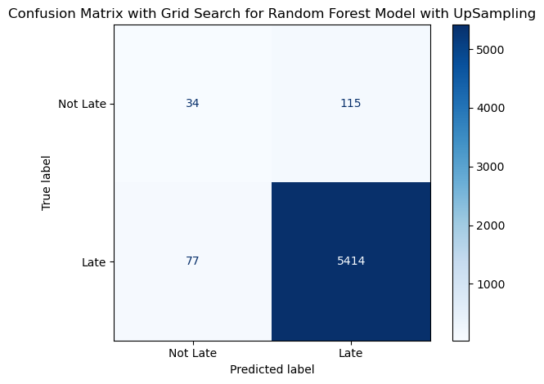
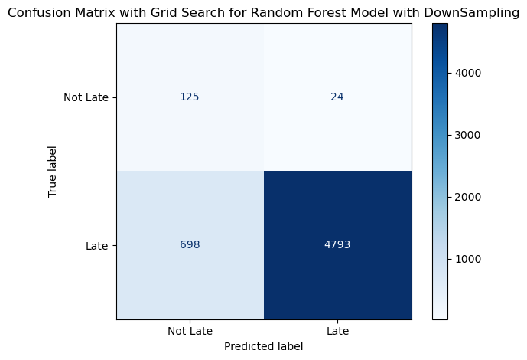
Appendix [2]
Confusion Matrix with Grid Search for Random Forest with Upsampling
Confusion Matrix with Grid Search for Random Forest with Downsampling

Slide 32

Appendix [3]
Confusion Matrix with Grid Search for Gradient Boosted Tree with downsampling

